Slide 1

MLPs and Backprop
Applied Machine Learning Derek Hoiem
Dall-E

Slide 2
Review from the practice questions
True or False:
Unlike SVM, linear logistic regression loss always adds a non-zero penalty over all training data points.
The PEGASUS algorithm computes the gradient for the optimization algorithm using only one sample out of the training data points – instead of using the whole dataset – thus increasing its computational efficiency.
PEGASUS has the disadvantage that the larger the training dataset, the slower it can be optimized to reach a particular test error.

Slide 3
Multi-layer Perceptrons (MLPs)
What is a perceptron
What is an MLP
Layers
Activations
Losses
How do we optimize with SGD and back-propagation

Slide 4
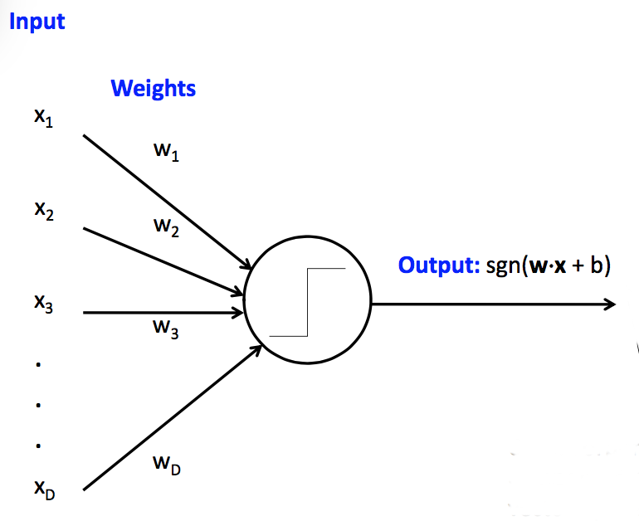
Perceptron
Perceptron = thresholded linear prediction model for classification
Very similar to linear logistic regression, though perceptron does not imply a particular error or training objective
sgn returns -1 for negative inputs and +1 for positive inputs
Fig source: CS 440

Slide 5

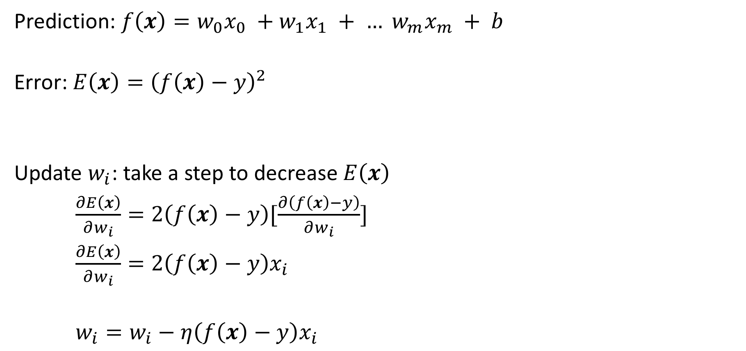
Perceptron Update Rule
Prediction: $f\left(x\right)=w_{0}x_{0} +w_{1}x_{1} + … w_{m}x_{m} + b$
Error: $E\left(x\right)={\left(f\left(x\right)−y\right)}^{2}$
Update $w_{i}$: take a step to decrease $E\left(x\right)$
$\frac{∂E\left(x\right)}{∂w_{i}}=2\left(f\left(x\right)−y\right)[\frac{∂\left(f\left(x\right)−y\right)}{∂w_{i}}]$
$\frac{∂E\left(x\right)}{∂w_{i}}=2\left(f\left(x\right)−y\right)x_{i}$
$w_{i}=w_{i}−η\left(f\left(x\right)−y\right)x_{i}$
prediction
target
Chain Rule:
$h\left(x\right)=f(g\left(x\right))$, then
$h^{′}\left(x\right)=f^{′}\left(g\left(x\right)\right)g′(x)$
(the 2 is folded into the learning rate)
Make error lower
Learning rate

Slide 6
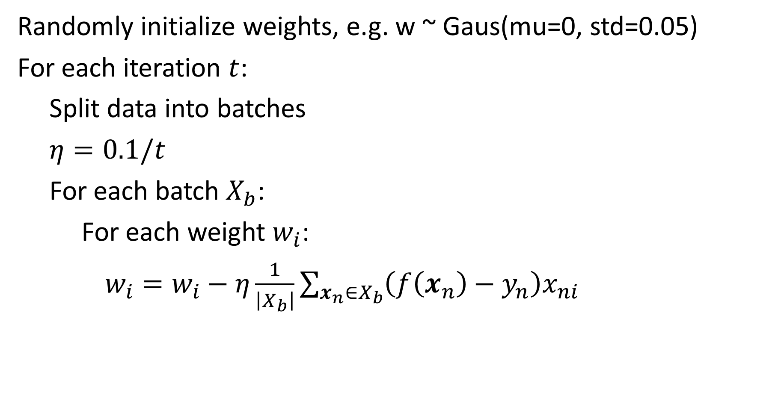
Perceptron Optimization by SGD
Randomly initialize weights, e.g. w ~ Gaus(mu=0, std=0.05)
For each iteration $t$:
Split data into batches
$η=0.1/t$
For each batch $X_{b}$:
For each weight $w_{i}$:
$w_{i}=w_{i}−η\frac{1}{\left|X_{b}\right|}\sum_{x_{n}∈X_{b}}{\left(f\left(x_{n}\right)−y_{n}\right)x_{ni}}$

Slide 7

With different loss, the update changes accordingly
Logistic loss:
$f\left(x\right)=w_{0}x_{0} +w_{1}x_{1} + … w_{m}x_{m} + b$
$P\left(y|x\right)=\frac{1}{1+\exp\left(−yf\left(x\right)\right)}, y∈\{−1,1\}$
$E\left(x\right)=−log{P\left(y|x\right)}$
$w_{i}=w_{i}+η\frac{1}{\left|X_{b}\right|}\sum_{x_{n}∈X_{b}}{y_{n}x_{ni}\left(1−P(y=y_{n}|x_{n})\right)}$
decrease –logP(y|x) → increase logP(y|x)

Slide 8
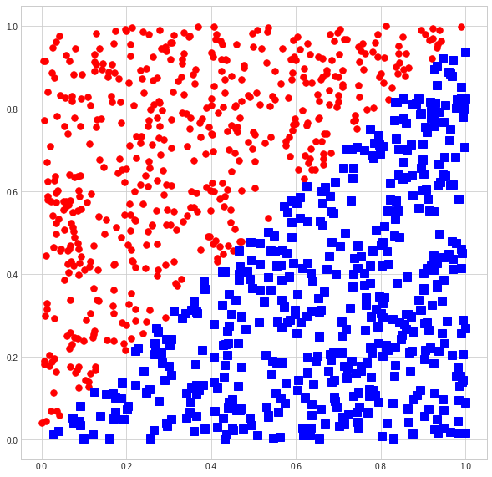
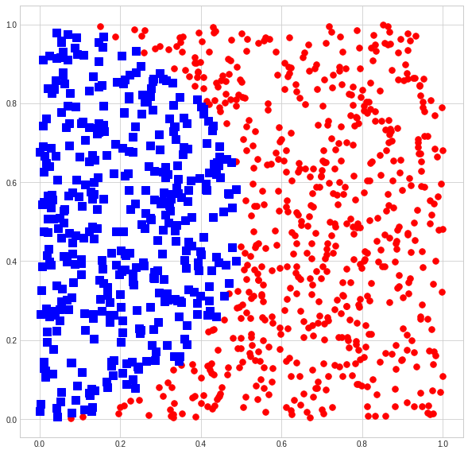
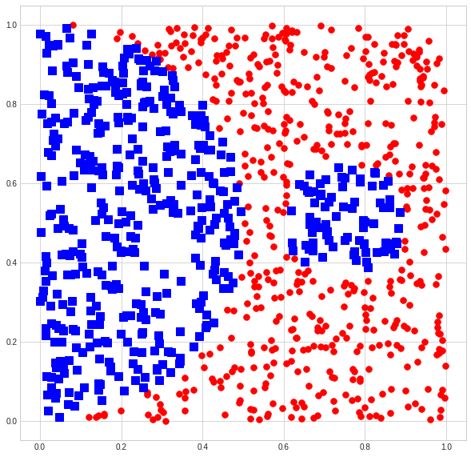
Is a perceptron enough?
Which of these can a perceptron solve (fit with zero training error)?

Slide 9
Demo
https://colab.research.google.com/drive/1nKNJyolqgzW53Rz59M2BZtyQM8bbrExb?usp=sharing

Slide 10
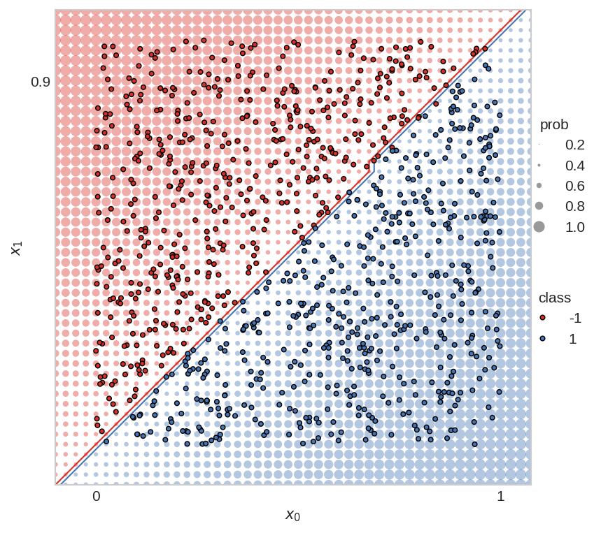
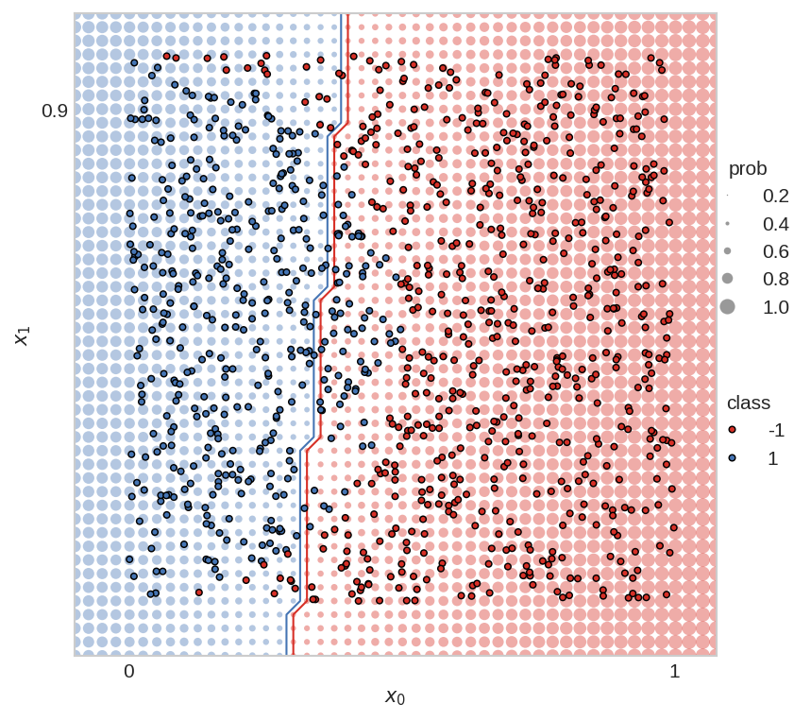
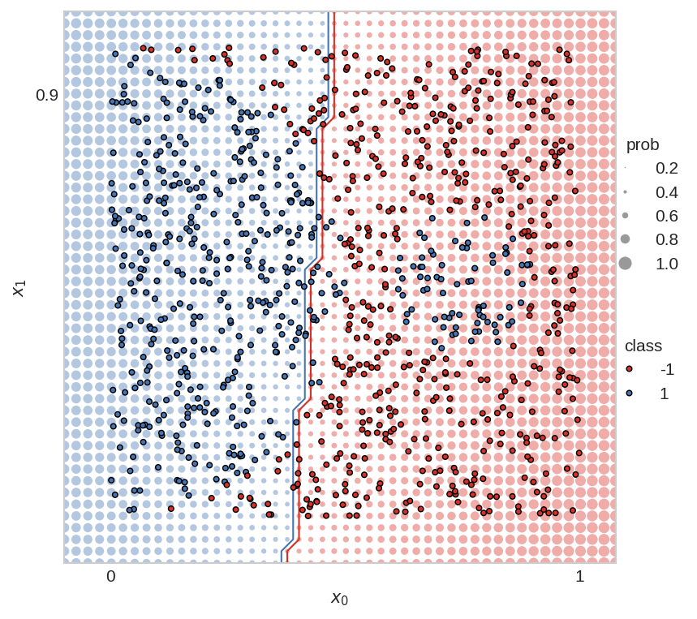
Perceptron is often not enough
Perceptron is linear, but we often need a non-linear prediction function
Which of these can a perceptron solve (fit with zero training error)?
Yes
No
Not even close

Slide 11
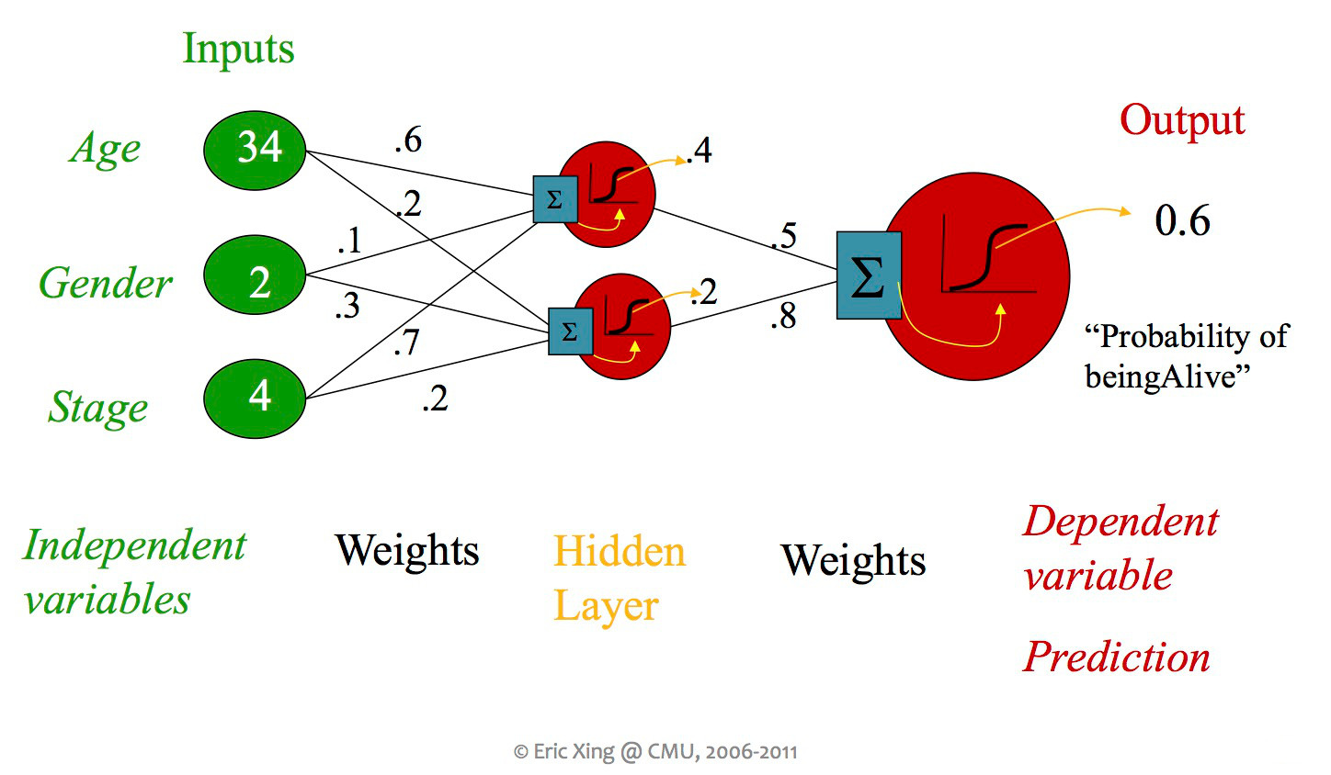
Multi-Layer Perceptron (MLP)
Nodes in hidden layer(s) encode latent relationships
Latent = hidden, not explicitly identified
Fig source: CS 440

Slide 12
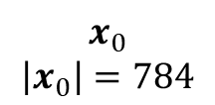
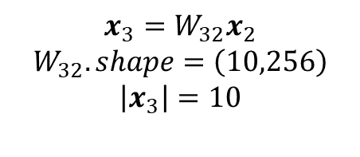
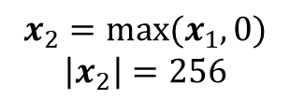
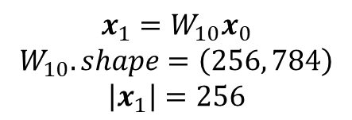
Example MLP for MNIST Digits
Input: # of features (one per pixel)
Fully connected (FC) layer(s): linear feature transformations
Non-linear activation: enables complex functions to be modeled by multiple FC layers
Output: score per class
$$x_{0}$$
$$\left|x_{0}\right|=784$$
Input Values (28x28=784)
$$x_{1}=W_{10}x_{0}$$
$$W_{10}.shape=\left(256, 784\right)$$
$$\left|x_{1}\right|=256$$
Fully Connected Layer (784->256)
$$x_{2}=\max{(x_{1},0)}$$
$$\left|x_{2}\right|=256$$
ReLU Activation
$$x_{3}=W_{32}x_{2}$$
$$W_{32}.shape=\left(10,256\right)$$
$$\left|x_{3}\right|=10$$
Fully Connected Layer (256->10)
Output Values (10)
Total parameters: (256 x (784+1)) + (10 x (256+1)), +1 is for bias terms

Slide 13
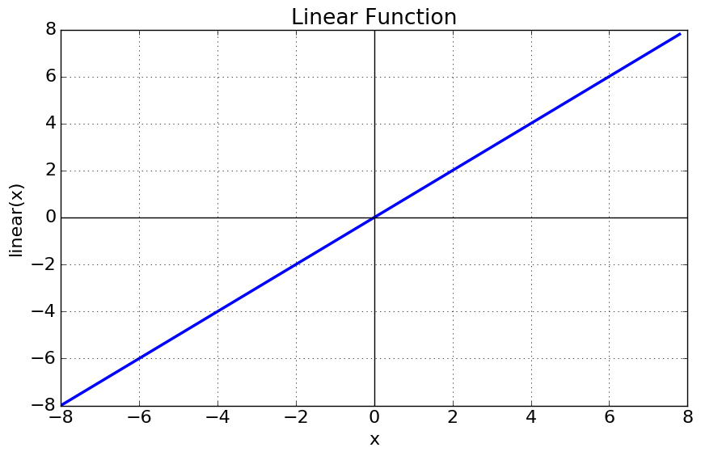

Linear activation
A no-op activation (i.e. nothing happens)
Could be used for information compression or data alignment
Multiple stacked linear layers are equivalent to a single linear layer
$$f\left(x\right)=x$$
$$f′\left(x\right)=1$$

Slide 14
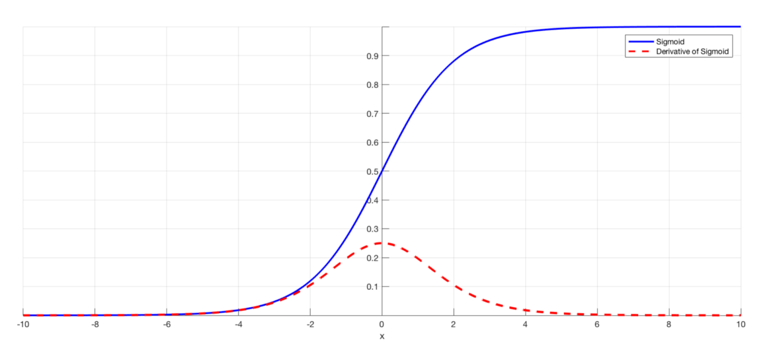

Sigmoid activation
Maps any value to 0 to 1 range
Traditionally, a common choice for internal layers
But weak gradients at extremum make it difficult to optimize if there are many layers (“vanishing gradient problem”)
Common choice for output layer to map to a probability
$$f\left(x\right)=\frac{1}{1+\exp\left(−x\right)}$$
$$f′\left(x\right)=f(x)(1−f\left(x\right))$$
Fig source

Slide 15
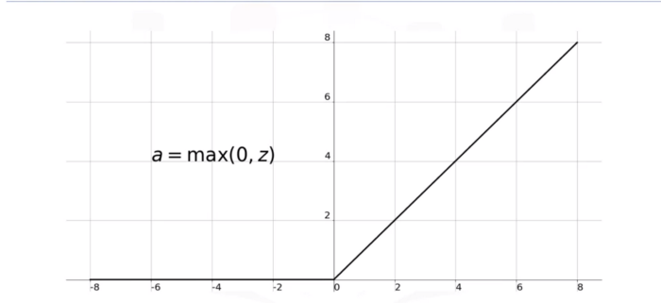

ReLU (Rectified Linear Unit) activation
Maps negative values to zero; others pass through
Most choice for internal layers in current deep networks
Results in sparse network activations, and all positive values have gradient of 1
$$f\left(x\right)=max⁡(0, x)$$
$$f′\left(x\right)=δ(x>0)$$
Fig source

Slide 16
MLP Architectures: Hidden Layers and Nodes
Number of internal (“hidden”) layers
Without hidden layers, neural networks (a.k.a. perceptron or linear logistic regressor) can fit linear decision boundaries
With enough nodes in one hidden layer, any Boolean function can be fit but the number of nodes required grows exponentially in the worst case (because the nodes can enumerate all joint combinations)
Every bounded continuous function can be approximated with one hidden sigmoid layer and one linear output layer
Any function can be approximated to arbitrary accuracy by a network with two hidden layers with sigmoid activation (Cybenko 1988)
Does it ever make sense to have more than two internal layers?
Number of nodes per hidden layer (often called the “width”)
More nodes means more representational power and more parameters
Each layer has an activation function

Slide 17
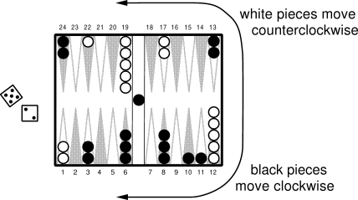
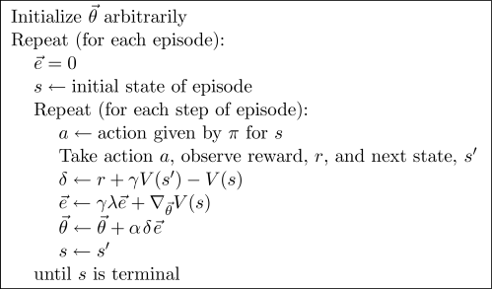
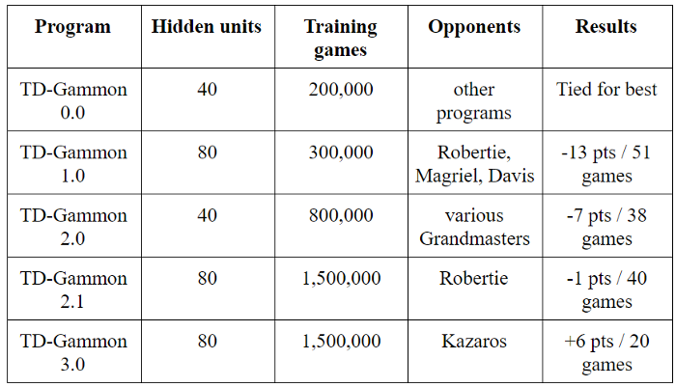
Application Example: Backgammon (1992)
198 inputs: how many pieces on each space
Later versions had expert-defined features
1 internal FC layer with sigmoid activation
Reinforcement learning: reward is evaluation of game position or result
Network competed well with world experts, demonstrating power of ML
https://en.wikipedia.org/wiki/TD-Gammon
Fig source

Slide 18
Back-propagation: network example
Consider this simple network
Two inputs
Two nodes in hidden layer
One output
For now, linear activation
Output is a weighted sum of middle nodes
Each middle node is a weighted sum of inputs
Error function is squared error

Slide 19

Back-propagation: output weights
Apply chain rule to solve for error gradient wrt $w_{35}$
Take step in negative gradient direction
Error gradient
Input to weight

Slide 20
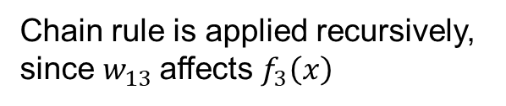
Back-propagation: internal weights
Chain rule is applied recursively, since $w_{13}$affects $f_{3}\left(x\right)$
Gradient update is product of gradient to output, gradient of this output to final output, and error gradient of final output
Gradient of this output
Error gradient
Contribution of this output to final output

Slide 21
What if f3 had ReLU activation?
(before, with linear activation)
Gradient is zero if x1<=0;
otherwise, same as for linear activation

Slide 22
Backpropagation: General Concept
Each weight’s gradient based on one training sample is a product of:
Gradient of loss function (should final output have been higher or lower)
Gradient of prediction wrt activation (how this node’s activation is affecting the final prediction)
Gradient of activation wrt weight (how is the weight changing its node’s activation)

Slide 23
2 Min Break Question
Assuming all linear layers (for simplicity), fill in the terms for the error gradients
x1
w1
h1
w2
g1
w4
w5
w6
w3
w7
out
x2
h2
g2
w0
w8
w9
w0
w9
w3
w7
x2
Error gradient wrt w8 = 2*(out-y)*(___*___ + ____*____) * ____
Error gradient wrt w2 = 2*(out-y)*(____) * _____
w3
h1

Slide 24
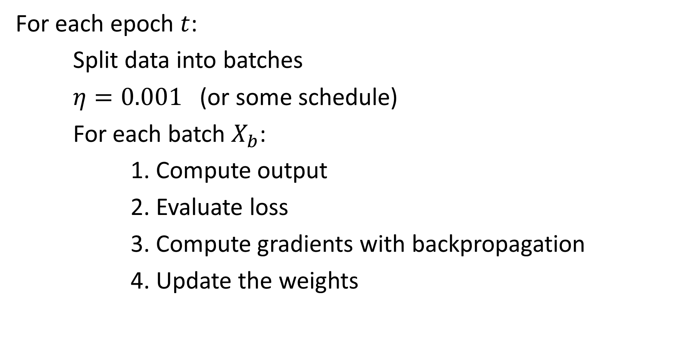
MLP Optimization by SGD
For each epoch $t$:
Split data into batches
$η=0.001$ (or some schedule)
For each batch $X_{b}$:
1. Compute output
2. Evaluate loss
3. Compute gradients with backpropagation
4. Update the weights

Slide 25
What is the benefit and cost of going from a perceptron to MLP?
Benefit
Much greater expressivity, can model non-linear functions
Cost
Optimization is no longer convex, globally optimum solution no longer guaranteed (or even likely)
Larger model = more training and inference time
Larger model = more data required to obtain a good fit
In summary: MLP has lower bias and higher variance, and additional error due to optimization challenges

Slide 26
Demo: Part 2
https://colab.research.google.com/drive/1nKNJyolqgzW53Rz59M2BZtyQM8bbrExb?usp=sharing

Slide 27
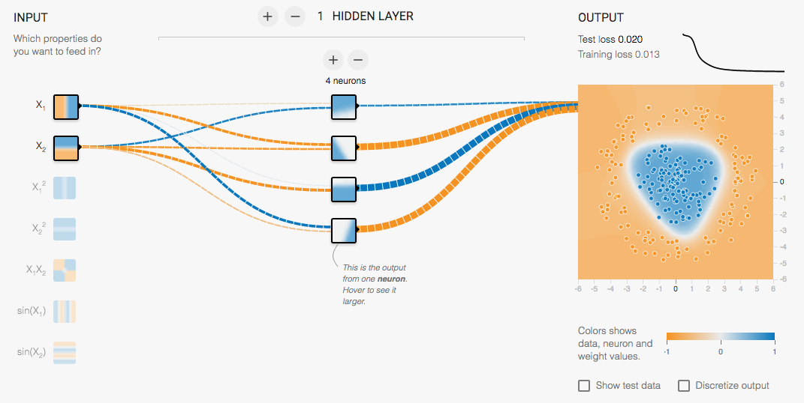
Multi-Layer Network Demo
http://playground.tensorflow.org/
Try many layers with sigmoid vs relu
Slide: Lazebnik

Slide 28
Another application example: mapping position/rays to color
L2 loss
ReLU MLP with 4 layers and 256 channels (nodes per layer)
Sigmoid activation on output
256 frequency positional encoding
Fourier Features (Tancik et al. 2020)
NeRF (Mildenhall et al. 2020)

Slide 29
HW 2
https://docs.google.com/document/d/13vTEGx3fdfc4rtcF86xoUyXm6eHmuvys5ZkMbcEgK4s/edit

Slide 30
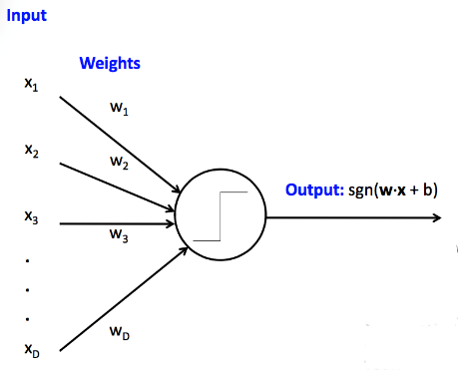

What to remember
Perceptrons are linear prediction models
MLPs are non-linear prediction models, composed of multiple linear layers with non-linear activations
MLPs can model more complex functions, but are harder to optimize
Optimization is by a form of stochastic gradient descent
Figure source

Slide 31
Next class
Deep learning
Background
AlexNet
Adam Optimization
Residual Networks

